Slide 1
Material and Information Flow Improvement - Paint Shop
Presented by:
Priya Jha
Under the guidance of:
Amar N Pawar Sir

Slide 2
MATERIAL FLOW
VSM is a Lean methodology for visualizing and optimizing end-to-end processes, driving Continuous Improvement.
Current State-> Where is the waste?
Future state ->
How do we maximize customer value efficiently?
Current state
Identify waste
Future state
Implement
Measure & Adjust
Defects
Overproduction
Waiting
Non-utilized Talent
Transportation
Inventory
Excess Processing
Motion
Needs
Feedback
Value
Flow
Control
Prioritization
Balance
Continuous incremental improvement

Slide 3

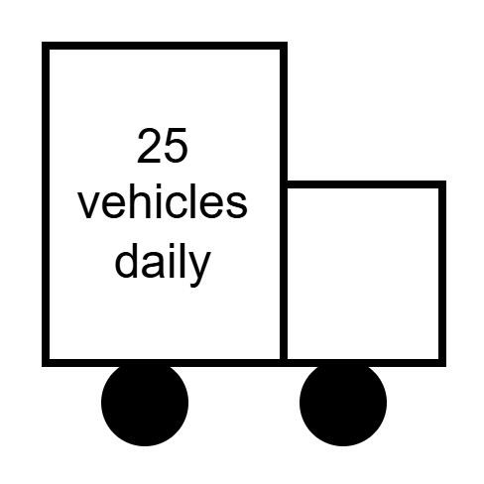
Current VSM of Paintshop
Information Flow
Production plan
Paintshop
Sales team-monthly production plan
PPC
Lumax
Process
Varroc polymer
Unloading and Dispatch
Vendors
Material Flow
Process
Process
Process
Process
Process
Process
Process
Receipt of molded /
metal parts & inspection
Loading molded / metal parts on secondary jigs
Pre-treatments-cleaning & Rinsing
Dry off oven
Painting Process
Inspection
3M sanding and polishing
Takt time | 48 sec
Cycle time | -50 sec
Inventory nos | 500 min , 650 max
Work station | 1
Workmen | 6
OEE% | 87%
Rejection | 1%
Takt time | 48 sec
Cycle time | -45 sec
Inventory nos | 500 min , 650 max
Work station | 3
Workmen | 7
OEE% | 87%
Rejection | 1%
Takt time | 48 sec
Total time | -630 sec
Inventory nos | 500 min , 650 max
Work station | 4
Workmen | 2
OEE% | 87%
Rejection | 1%
Takt time | 48 sec
Total time | -1260 sec
Inventory nos | 500 min , 650 max
Work station | 2
Workmen | 4
OEE% | 87%
Rejection | 1%
Takt time | 48 sec
Total time | 2417 sec
Inventory nos | 500 min , 650 max
Work station | 10
Workmen | 18
OEE% | 87%
Rejection | 1%
Takt time | 48 sec
Cycle time | 50 sec
Inventory nos | 500 min , 650 max
Work station | 2
Workmen | 7
OEE% | 87%
Rejection | 1%
Takt time | 48 sec
Cycle time | 70 sec
Inventory nos | 500 min , 650 max
Work station | 2
Workmen | 18
OEE% | 87%
Rejection | 1%
Lead time(min)
45
10
60
20
10.5
21
40.28
NVA(min)
10
20
5
10
8
40

Slide 4
Improvement Scopes
Area | Stage | Type of Waste | Description of Waste | Idea
Material flow | Transportation from receipt area to paint conveyor 2 | Motion, Overprocessing | Manual handling leads to high MFI, inefficient transport, and manpower overuse (3 operators). | Replace with BOPT to reduce handling time and improve efficiency
 | Inspection | Low Manpower Utilization, Motion | 11 at unloading, 4 at inspection; split inspection stations cause idle manpower and uneven load distribution | Merge both inspection stations into one to eliminate idle time and improve manpower efficiency.
 | Sanding and Polishing | Motion, Transportation | Distant stations increase search time and manual transfers, affecting process flow and raising MFI | Introduce in-line sanding and polishing on conveyor to reduce extra movement and manual handling.
 | Dispatch | Delay | Suboptimal trolley loading leads to underutilized transport cycles and dispatch delays | Optimize trolley design/layout to ensure maximum space utilization and reduce dispatch delays.
Information flow | Dispatch–Vehicle Assembly Communication | Waiting / Defects | No structured communication between receipt, dispatch, and vehicle assembly unloading. Results in delayed updates, errors in delivery. | Implement App-Based Tracking System to ensure real-time coordination across dispatch and vehicle assembly points.

Slide 5
MATERIAL FLOW - PAINT SHOP

Slide 6
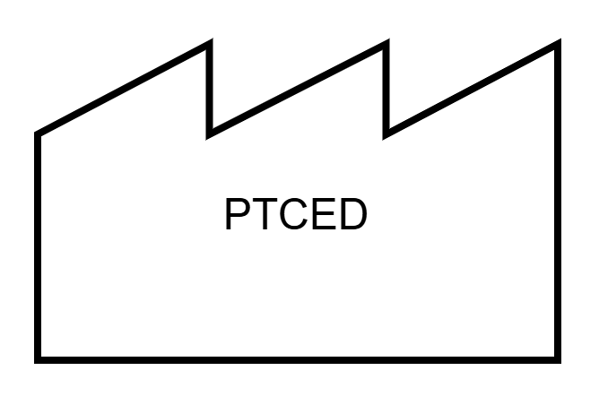
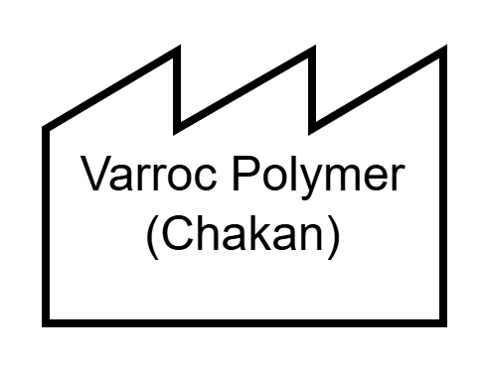
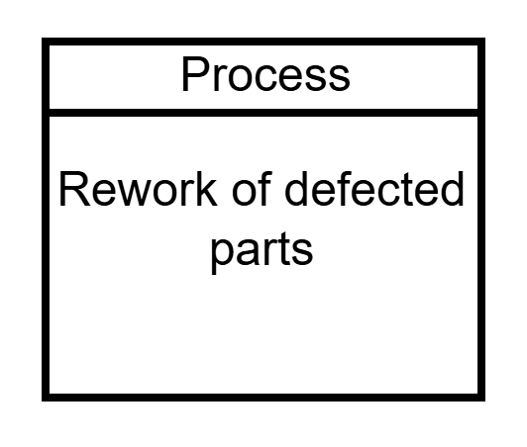
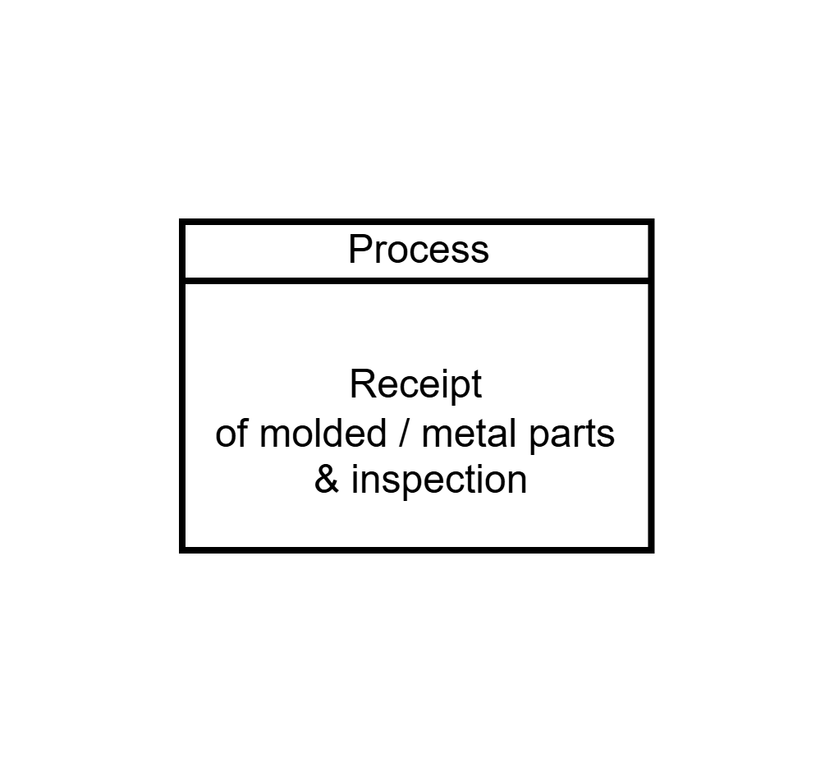
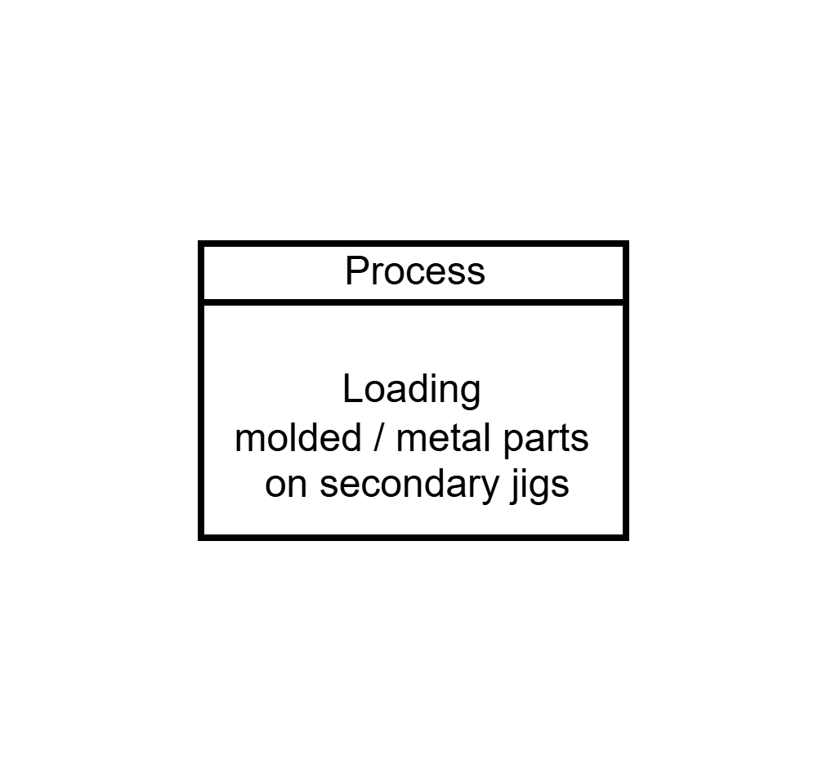

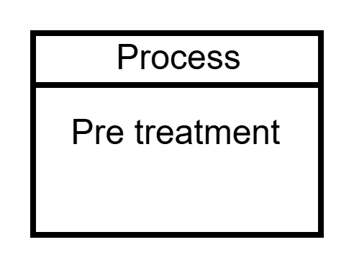
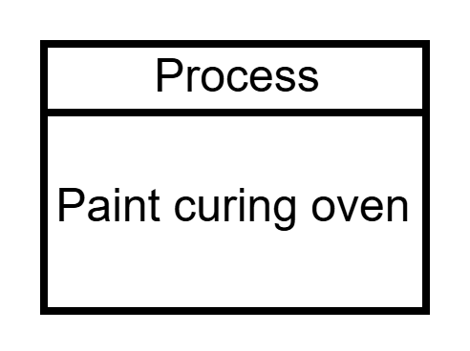
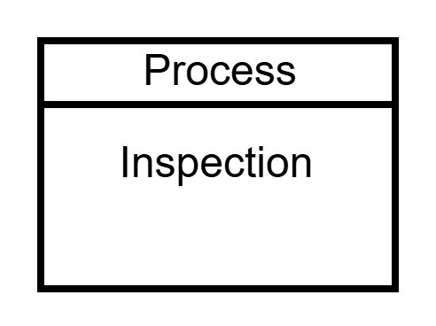
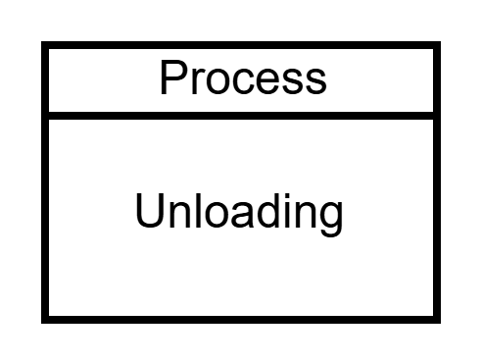
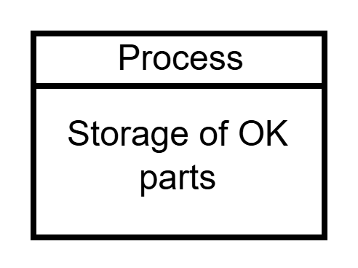
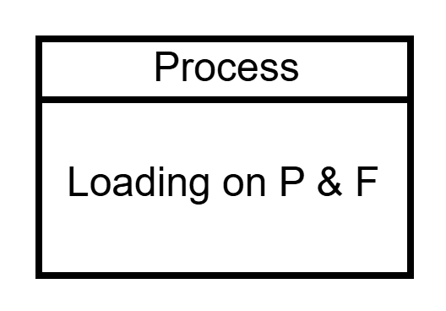
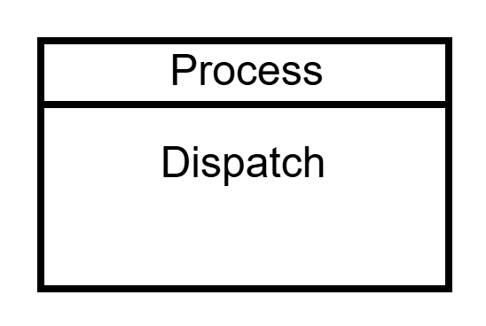
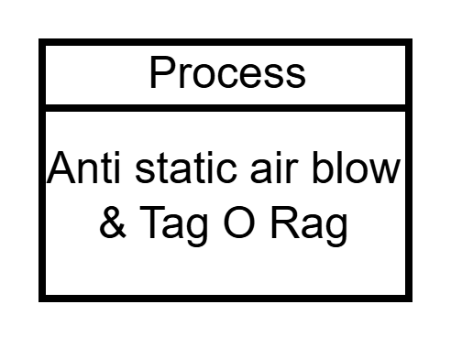
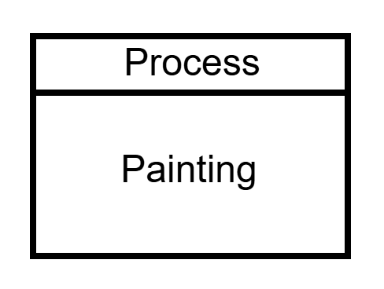
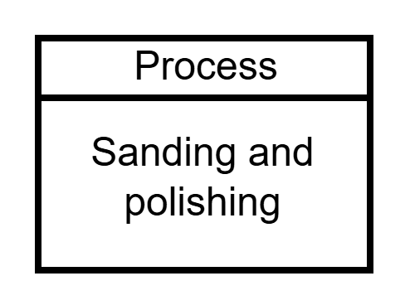
Process Flow Chart
Paint Conveyor line 2

Slide 7
Process Flow Chart
Takt time(in sec) = 48sec
Inventory nos = 500 min , 650 max
OEE% = 87%
Workmen = 86
Rejection = 1%

Slide 8
Transportation from receipt area to paint conveyor 2
Aspect | Current State | Proposed State
Mode of Handling | Trolley with manual movement | Trolley with BOPT (Battery Operated Pallet Truck)
MFI Index (Mode of Handling) | 3 (as per MFI rating chart: higher manual effort) | 2 (improved rating due to semi-automated handling method)
Remarks | Manual movement contributes to higher MFI (waste of motion and manpower). | BOPT reduces manual intervention, improves efficiency, and supports lean objectives.
Standard MFI calculations method is used based on mode of handling, quantity handled and travel distance.
Ideal Condition : 1*1*1
No Good Condition:
5*5*5 =125
Mode of Handling | Rating
Conveyor- point to point transfer | 1
Trolley/Bin with AGV / BOPT | 2
Trolley with manual movement | 3
L trolley with Bins manual movement | 4
Manual Movement | 5
Parts / Bins or Trolley | Rating
18-24 | 1
12-18 | 2
8-12 | 3
4-8 | 4
1-4 | 5
Distance in Meter | Rating
0-20 | 1
20-50 | 2
50-100 | 3
100-150 | 4
>150 | 5

Slide 9
2. Inline Sanding and Polishing station
Objective | Key Challenges | Proposed Solutions | Extra Material Required
Merge both inspection stations into one to eliminate idle manpower. | 1. Conveyor height is too high for inspecting components like handlebar. | 1. Provide elevated platform for operators to inspect taller components like handlebar. | Elevated platform
 | 2. Side panels require more surface area for inspection. | 2. Use roller-based movable inspection benches to ease side panel inspection. | roller-based benches
 | 3. Simultaneous arrivals create load imbalance | 3. Assign 1–2 floater operators during peak load to balance manpower.
Introduce in-line sanding and polishing on conveyor to avoid separate station. | 1. Conveyor speed (2.9 m/min) may make operation difficult | 1. Provide movable stools for better posture. | Movable stools
 | 2. Ergonomics may be poor while working on moving jigs. | 2. Attach pneumatic sanding/polishing guns near the conveyor line.
 | 3. Some parts are too large or complex to work on while moving. | 3. For large parts like side panel: provide a separate inspection table to remove, work, and rehang parts after next batch comes in
 |  | 4. Evaluate two options: (i) one combined sanding station after merged inspection or (ii) two small sanding stations after each inspection area.
Create a unified FG storage station to eliminate multiple substations. | 1. Cluster formation at unified unloading zone. | 1. Allocate specific spaces within the unified storage for each part type. Assign two workmen to handle sorting/unloading. | Multi-tier trolleys, racks.
 | 2. Limited space for sorting parts quickly. | 2. 40-meter distance in total and it takes ~14 minutes for from inspection to unloading. So the workmen have 14 minutes to complete inspection, sanding polishing and storage of one part.

Slide 10
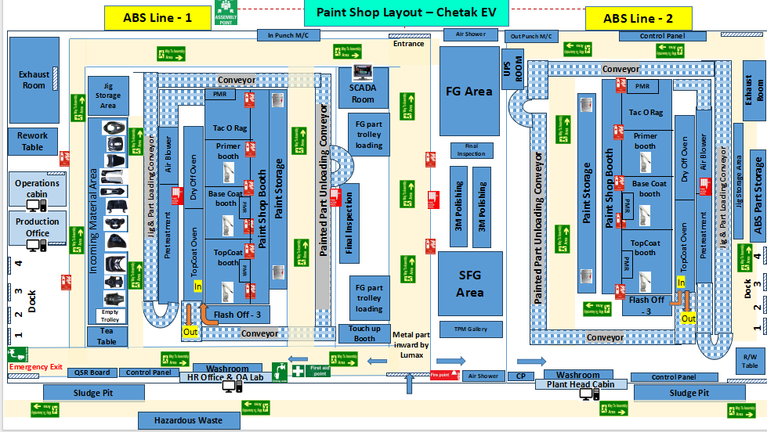
Paint Shop Layout

Slide 11
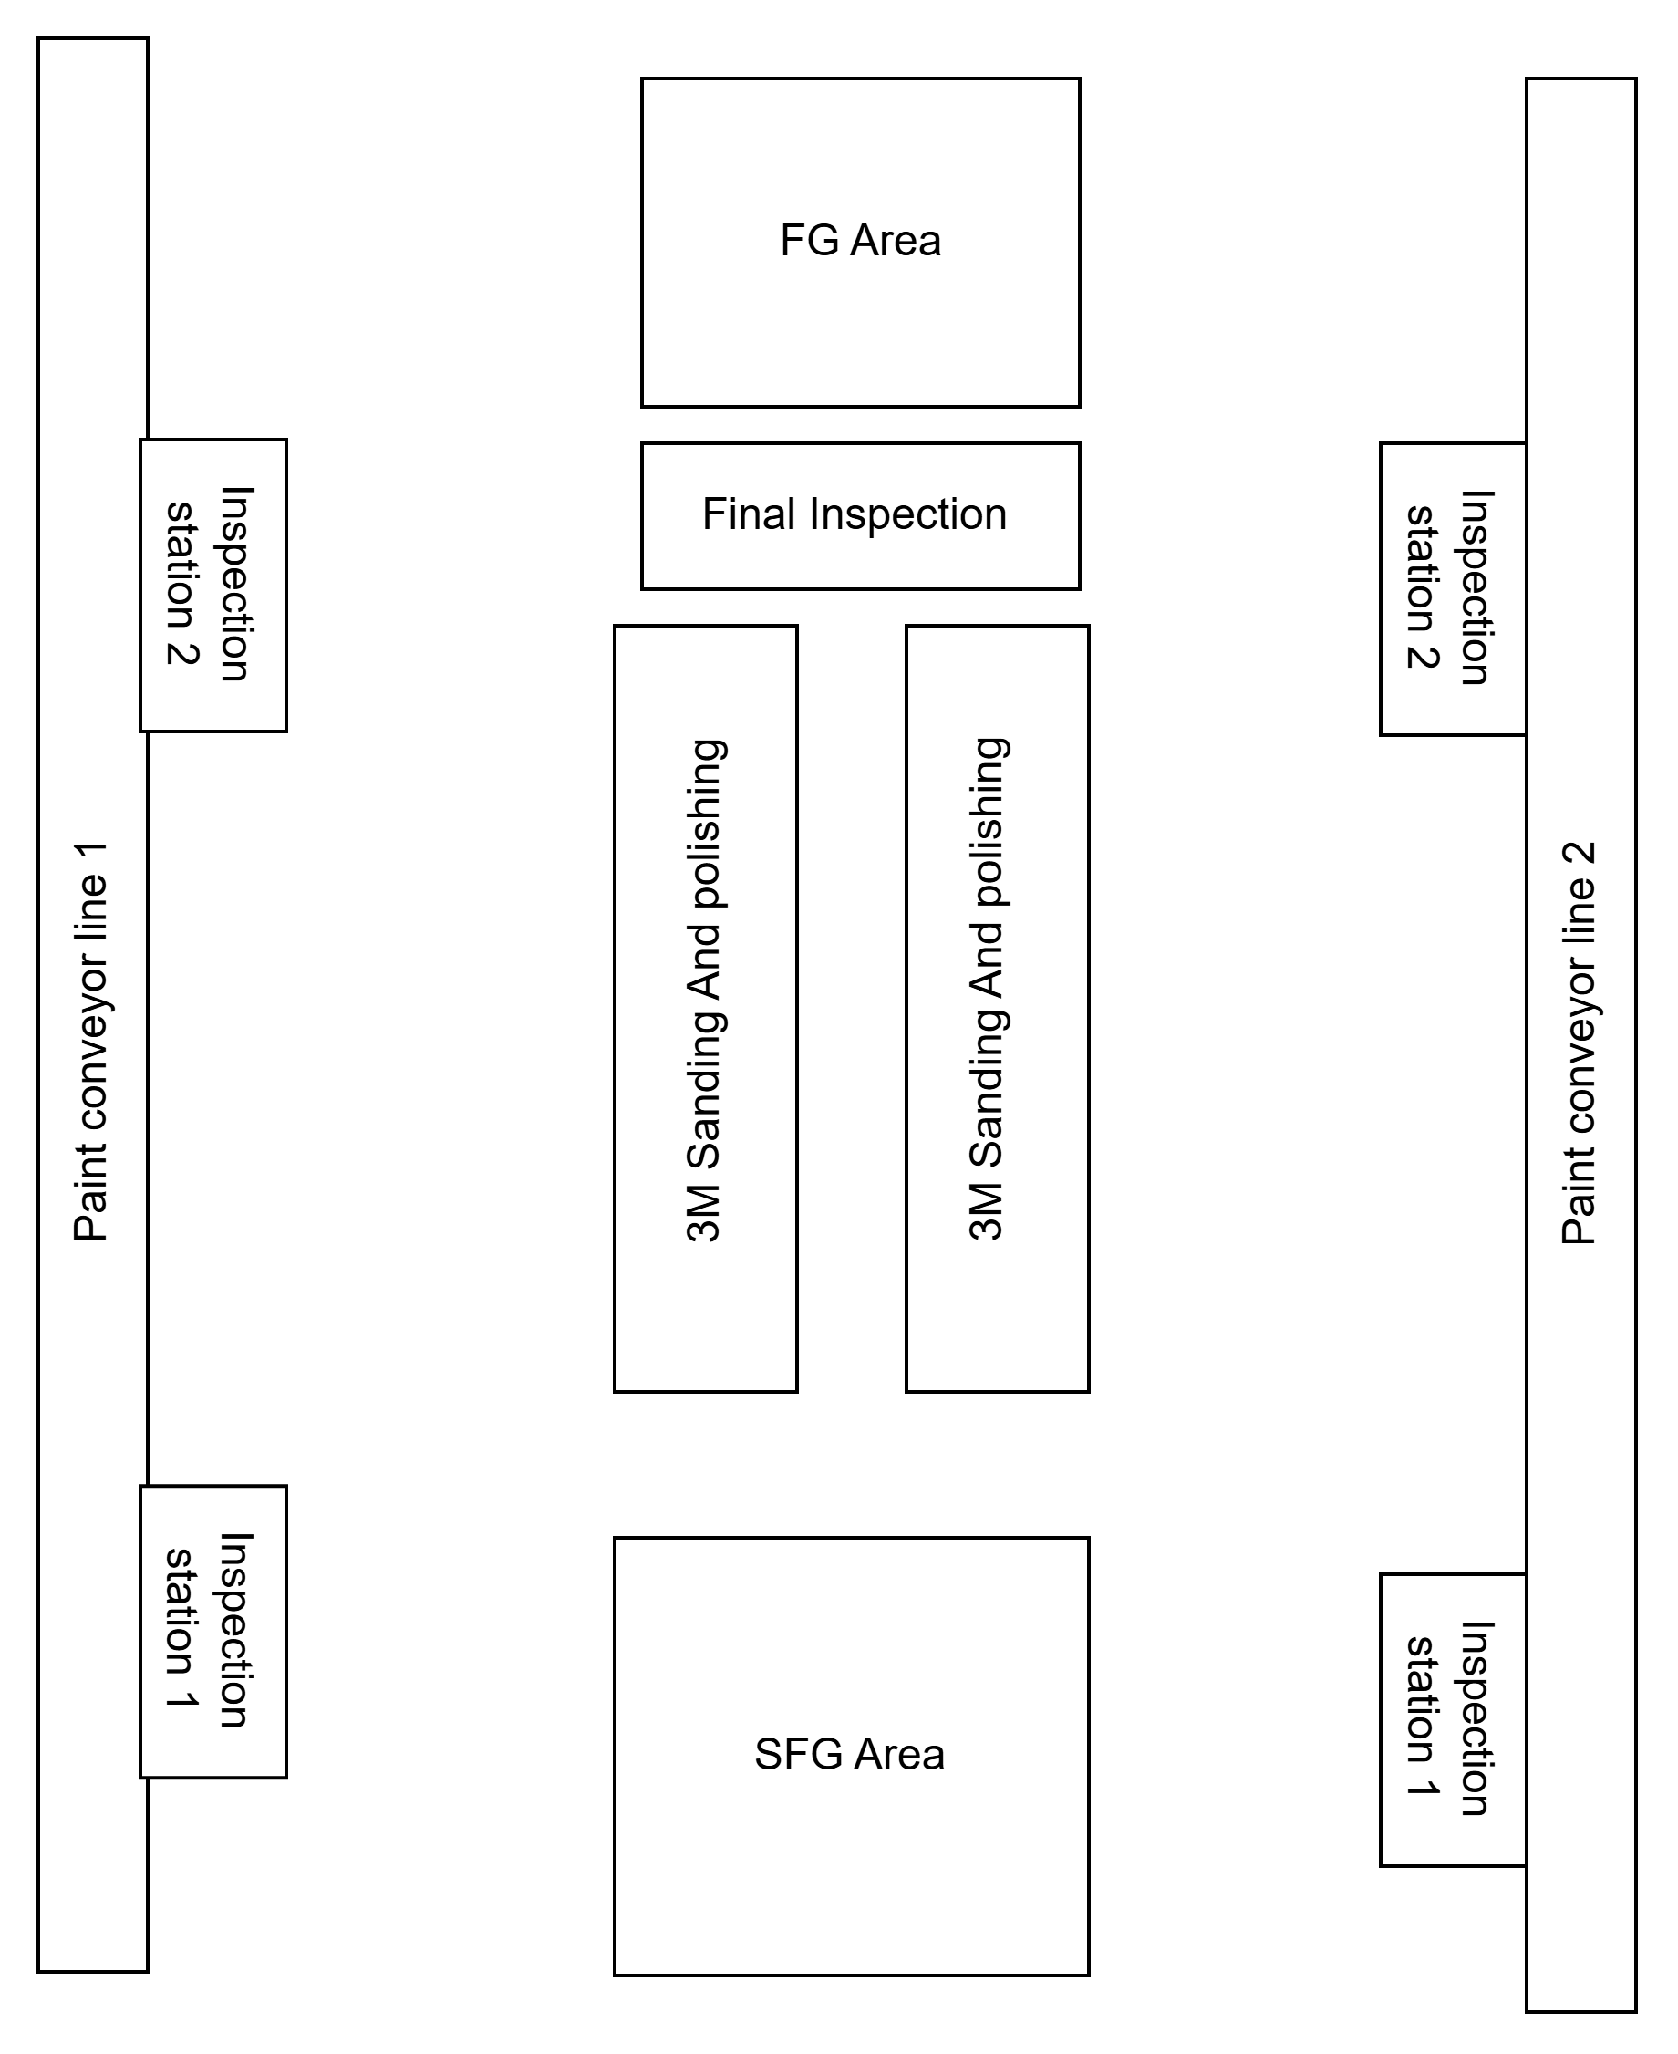
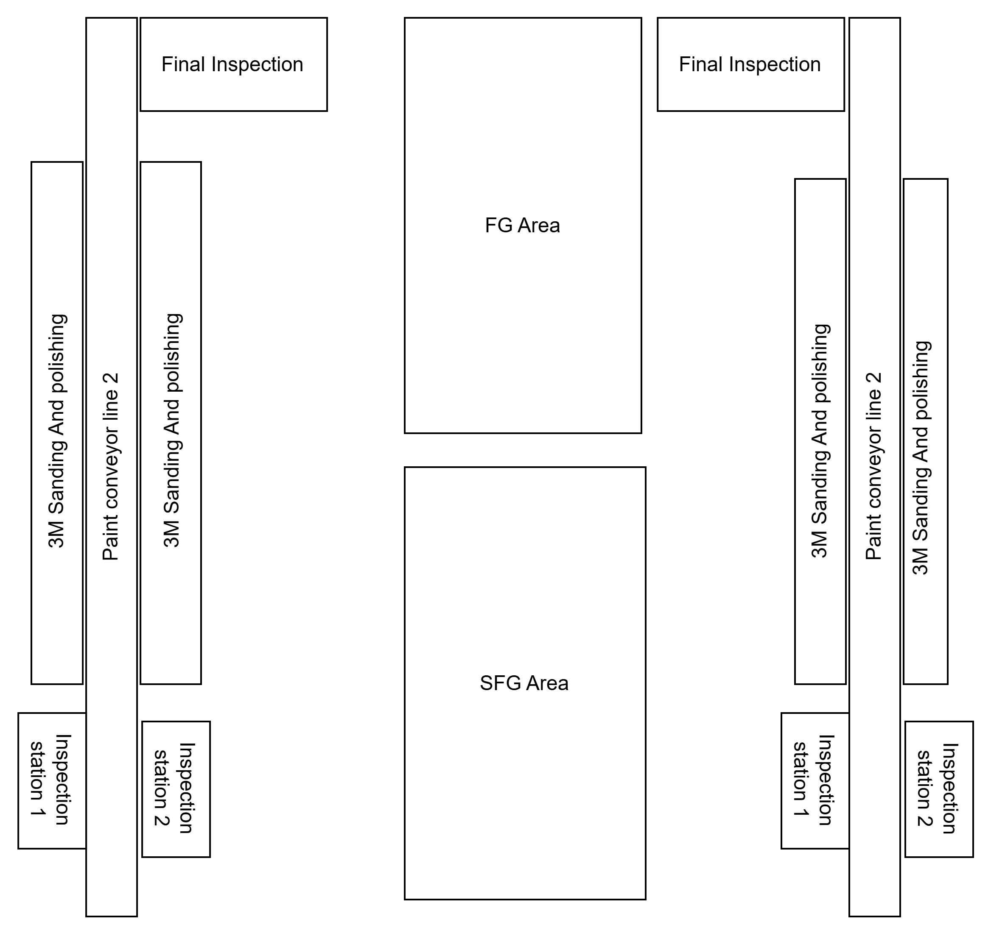
Current VS Proposed

Slide 12
Current VSM - Paint Shop
I
Unloading and manual transportation
Process
3M sanding and polishing
I
Process
Process
Takt time | 48 sec
Cycle time | 70 sec
Inventory nos | 500 min , 650 max
Work station | 2
Workmen | 18
OEE% | 87%
Rejection | 1%
Process
Process
Inspection station1
Inspection station 2
Loading on P & F and Dispatch
Storage
Takt time | 48 sec
Cycle time | 40 sec
Inventory nos | 500 min , 650 max
Work station | 1
Workmen | 2
OEE% | 87%
Rejection | 1%
Takt time | 48 sec
Cycle time | 40 sec
Inventory nos | 500 min , 650 max
Work station | 1
Workmen | 2
OEE% | 87%
Rejection | 1%
Takt time | 48 sec
Total time | 50 sec
Inventory nos | 500 min , 650 max
Work station | 1
Workmen | 4
OEE% | 87%
Rejection | 1%
Takt time | 48 sec
Total time | 120 sec
Inventory nos | 500 min , 650 max
Work station | 10
Workmen | 18
OEE% | 87%
Rejection | 1%
I
All parts except handle bar, side panel
Side panel and handle bar
Lead time(min)
25
10
60
NVA(min)
20
40

Slide 13
TIME STUDY – INSPECTION, SANDING & POLISHING
Jig Allocation for Parts Handling
3. 3M Sanding and Polishing:
Jig | Parts Handled
Jig 1 | Handle Bar, Neckpiece, Fender, Lower Shield
Jig 2 | Side Panel (2 pieces)
Jig 3 | 4 Rear Covers
Jig 4 | 4 Glove Boxs
Component | Sanding Time | Polishing Time
Handle Bar | 45 sec | 90 sec
Rear Cover | 25 sec | 50 sec
Fender | 50 sec | 120 sec
Neckpiece | 20 sec | 30 sec
Side Panel | 45 sec | 40 sec
1. Inspection Process:
4. Sanding and Polishing (Using Battery operarted Machine Gun):
Component | Manpower | Time Taken
Rear Shield (x4) | 2 | 40 sec(1 jig)
Fender | 1 | 13 sec
Lower Shield | 1 | 40 sec
Handle Bar (Pick & Check) | 2 | 30 sec
Side Panel | 2 | 30 sec
Handle Bar (Part Exchange) | 2 | 80 sec
Observation: Lower RPM, heavier tool Results in operator fatigue, heavy weight Takes ~2× more time than pneumatic guns
2. Unloading & Storage:
Activity: Manual lifting, walking, stacking of both OK parts and rework parts (3M)
Total Time= 55 sec, Manpower = 2
5. Total Time:
Total time from inspection till final stage:
840 seconds

Slide 14
Proposed VSM - Paint Shop
Process
Process
Process
Process
Process
Inspection station
3M Sanding Inline station
3M Polishing inlne station
Storage of FG
Loading on P & F and Dispatch
Takt time | 48 sec
Cycle time | 40 sec
Inventory nos | 500 min , 650 max
Work station | 1
Workmen | 2
OEE% | 87%
Rejection | 1%
Takt time | 48 sec
Cycle time | 30 sec
Inventory nos | 500 min , 650 max
Work station | 2
Workmen | 18
OEE% | 87%
Rejection | 1%
Takt time | 48 sec
Cycle time | 40 sec
Inventory nos | 500 min , 650 max
Work station | 2
Workmen | 18
OEE% | 87%
Rejection | 1%
Takt time | 48 sec
Total time | 50 sec
Inventory nos | 500 min , 650 max
Work station | 1
Workmen | 4
OEE% | 87%
Rejection | 1%
Takt time | 48 sec
Total time | 120 sec
Inventory nos | 500 min , 650 max
Work station | 10
Workmen | 18
OEE% | 87%
Rejection | 1%
Lead time(min)
25
10
60
NVA(min)
2
40

Slide 15
Current vs Proposed
The current vs proposed total manpower deployed across both ABS Line 1 and Line 2 in the paint shop, from inspection to dispatch.
S. No | Stages | Activity | Current Manpower / shift | Proposed Manpower / shift
1. | Inspection | LH side - 2 (1 for upper & 1 for lower parts) RH side - 2 (1 for upper & 1 for lower parts) | 6 | 4
2. | For Quality Report | All Parts | 1 | 1
3. | Sanding & polishing | Sanding - 4 & Buffing - 4 LH side - 2 (1 for upper & 1 for lower parts) RH side - 2 (1 for upper & 1 for lower parts) After painting / Reprocess | 18 | 16
4. | Unloading | Unloading : take out the part from hanger and put in the trolley 2 - for top side loading 2 - for bottom side loading | 4 | 2
5. | Loading on P & F | Trolley shifting from IQC to loading area and return back empty trolley | 3 | 3
6. | Dispatch | Dispatch monitoring | 1 | 1
 |  | Total | 33 | 27

Slide 16
Process Streamlining & Time Optimization
Time Comparison (Per Part):
Stage | Current Time (sec) | Proposed Time (sec) | Remarks
Inspection | 39 | 39 | No change; part check remains same
Unloading & Transportation | 50 | ❌ Eliminated | Manual handling removed; now inline flow
Sanding | 33 | 33 | Integrated into main process
Polishing | 59 | 59 | Integrated into main process
Final Storage (Finished Goods) | 60 | 60 | No change
Total Time | 241 sec | 191 sec | Time saved: 50 sec/part
Total Time Saved: 50 seconds per part
~21% reduction in processing time per part

Slide 17
Improvements Achieved Through Process Optimization
Significant Lead Time Reduction:
Manual transportation post-inspection was eliminated, directly reducing non-value-added time and lowering lead time per part by ~21%.
Improved Material Flow Index (MFI):
Consolidated operations (e.g., sanding and polishing) into a single flow line, reducing inter-process handling and increasing MFI efficiency.
Eliminated Substation Dependency:
The need for a separate inspection/sanding station was removed, streamlining process flow and reducing layout complexity.
Process Kaizen Implemented:
Continuous improvement (Kaizen) led to better line balancing, ergonomic load distribution, and cycle time reduction.
Reduced Work-In-Progress (WIP):
Inline operations and better part tracking minimized buffer stock, lowering WIP inventory and floor space usage.
Process changes were guided by lean principles — reducing waste, improving flow, and enhancing throughput efficiency.”

Slide 18
Information Flow - Paint Shop

Slide 19
Current Information Flow & Challenges
SALES TEAM
Challenges in Current Flow
Stage | Problem
PPC | Plan delays → low opening balance
Vendors | No confirmation loop → material shortages
Paint Shop | Over-inventory due to delays → parts stored on ground → increased damage
WhatsApp/Manual Msgs/ Calls | Plan tracking is unclear → different teams may follow outdated schedules
Paint Process | No buffer; takes 4 hrs/part → last-minute plan changes cause production loss
PPC
→ Vendors
→ Paint Shop
→ Vehicle Assembly
Daily Plan Finalized by PPC
Overall Impact:
Information shared via WhatsApp/Calls
Every gap in information flow — from planning to execution — contributes to delays, shortages, and production loss.
Digitization bridges gaps in communication, planning, and visibility

Slide 20
Addressing Key Operational Challenges with PartTracker
Challenges in Existing System | How PartTracker App Solves It
Manual plan circulation through WhatsApp or calls | Digital production plans shared instantly through the app
No real-time visibility of part status | Live scanning updates for every part and trolley
Material shortages due to lack of confirmation | Real-time part availability shown in the dashboard
Over-inventory and space issues in the paint shop | Better tracking reduces excess stock and prevents floor storage
No traceability of part movement across departments | Complete scan history with time, part, and trolley details
Confusion about which plan is currently being followed | Central dashboard displays active shift plans and progress in real-time
No centralized data for auditing or verification | All plans and scans are stored securely in a centralized cloud database
Production loss due to delayed communication or shortages | Early alerts and real-time tracking allow quick corrective actions
PartTracker has reduced losses, improved traceability, and enabled efficient shift planning.

Slide 21


Experience the App: Download PartTracker
Website link: https://chucklechic.github.io/parttracker-download/
Drive link: https://drive.google.com/file/d/1cRO7eG6BtA13z3-UBfRH0gzTECD1mW7B/view?usp=sharing
QR code:
Scan this QR to instantly download the app!
SCAN ME
Live. Track. Optimize.

Slide 22
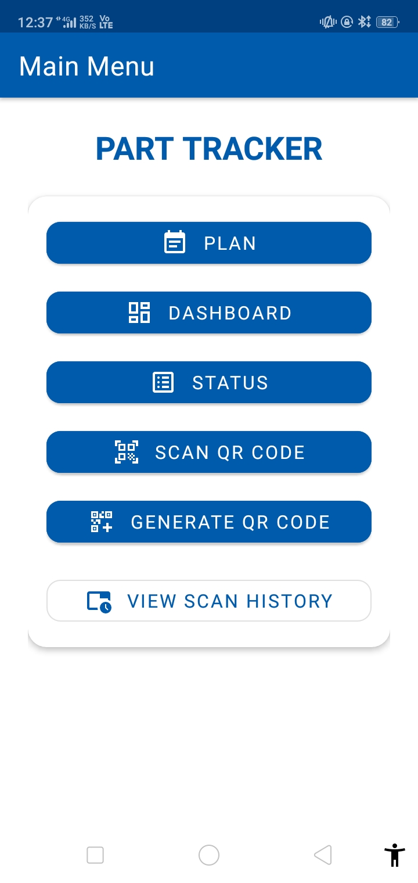






Technology Stack & Architecture
Component | Technology Used | Purpose
Frontend | Kotlin (Android) | Modern, concise, and reliable app development
UI Layout | XML + Layout Editor | Responsive interface design via drag-and-drop and XML
Local Storage | Room Database | Lightweight database for offline and real-time data
Architecture | MVVM | Structured separation of UI, data, and logic layers
Firebase | Shared Realtime Database | To ensure live data synchronization across multiple devices and users
These technologies together ensure speed, reliability, and a smooth user experience across real-time production environments.

Slide 23
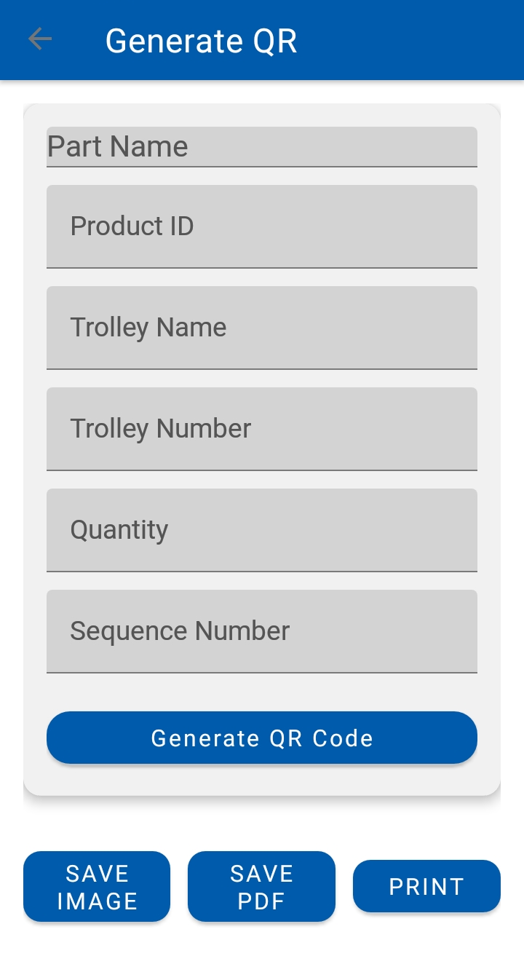
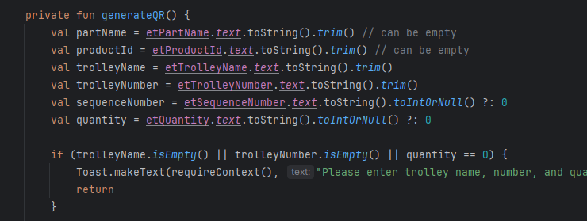
QR Code Generation in PartTracker
What happens here:
A QR code is generated based on the entered part, trolley, and quantity details
The generated QR is pasted permanently on trolleys along with the monthly PM check sheet
Handles the case of common trolleys for multiple parts
Avoids duplicate QR codes by generating one QR per trolley, not per part
Step 2
Step 1
// Kotlin snippet that powers QR logic

Slide 24
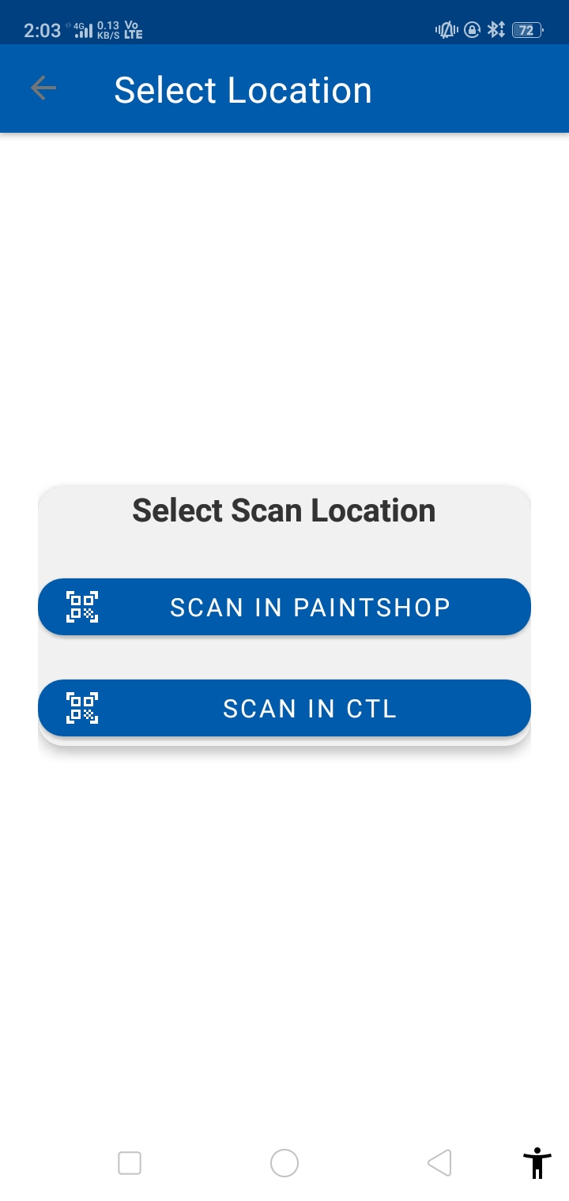
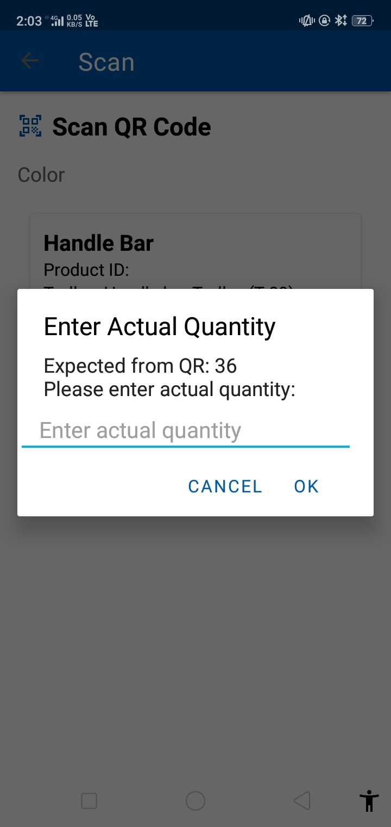
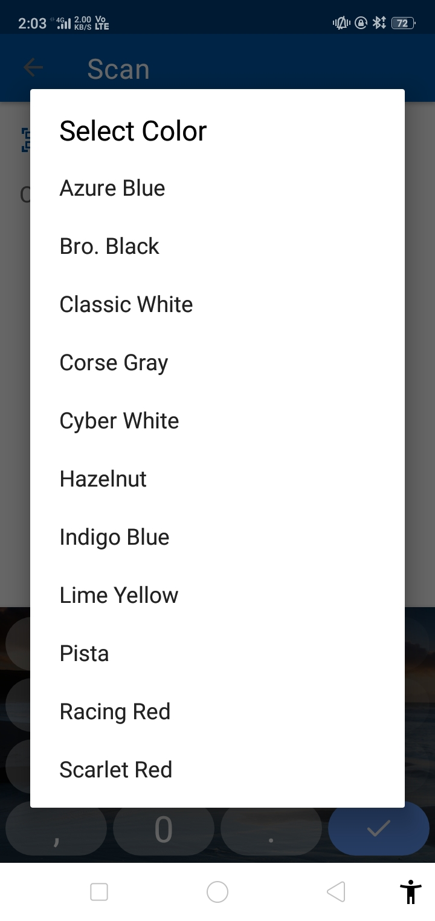
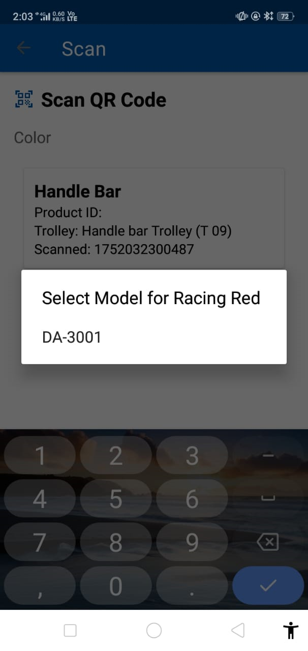
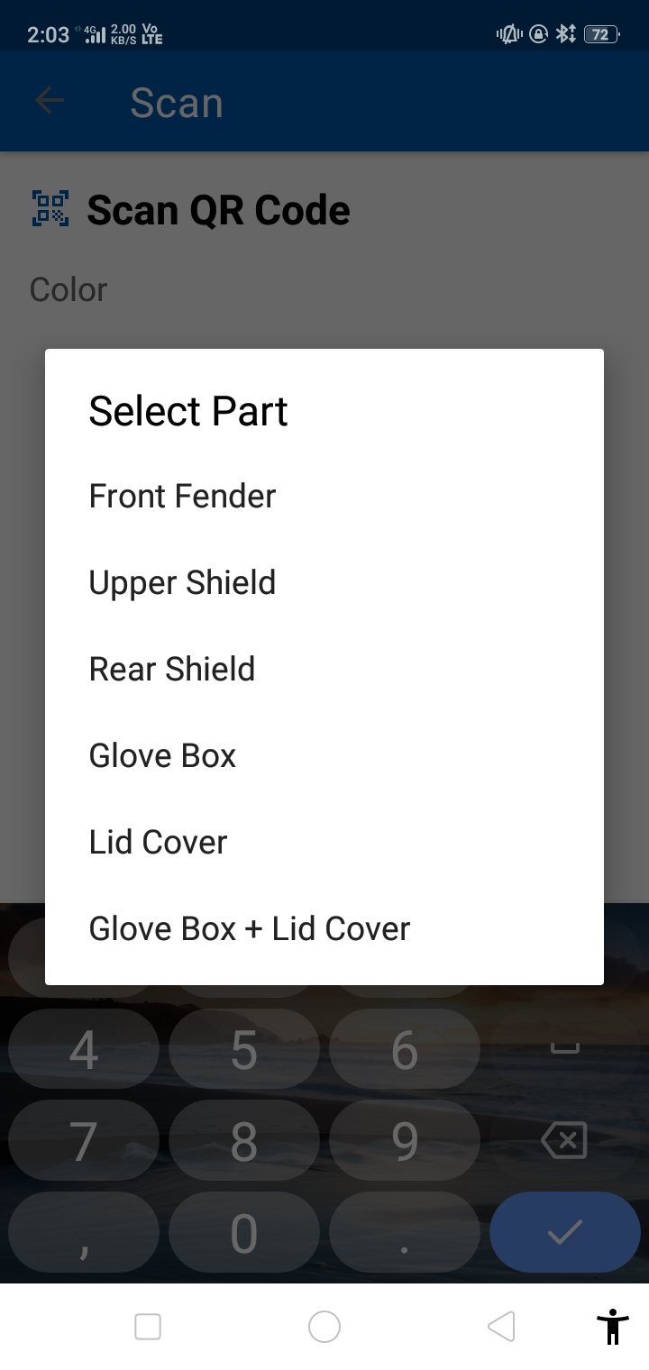
Scanning of QR Code in PartTracker
1. Select Scan Location
Choose where the QR code is being scanned — Paintshop or CTL
2. Enter Actual Quantity
Input the number of parts actually present in the trolley
3. Choose Part
Color
Select the color of the part as per production requirement
4. Choose Model for Selected Color
Select the model name linked to that part and color
5. Select Specific Part (Common Trolley)
Pick the exact part if the trolley contains multiple parts
This scanning process ensures correct part mapping, model validation, and accurate quantity tracking in real time.

Slide 25
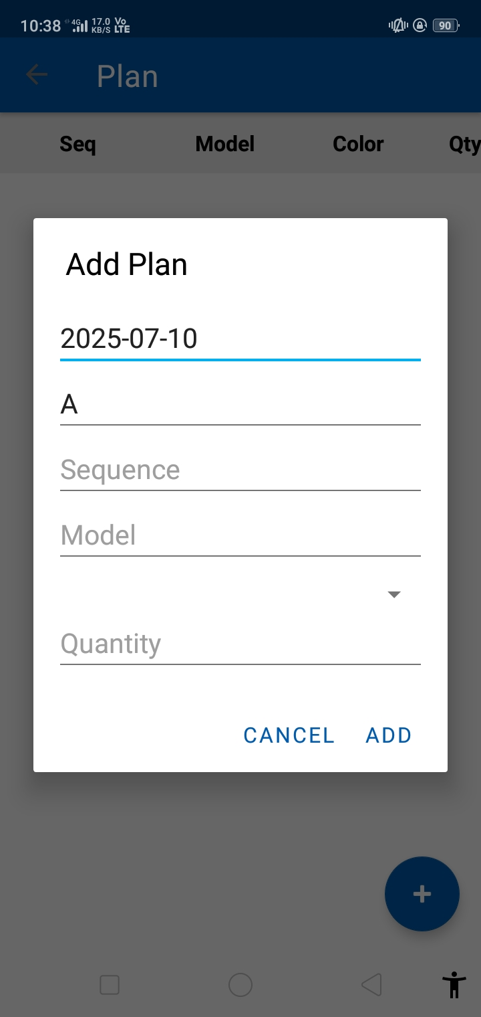
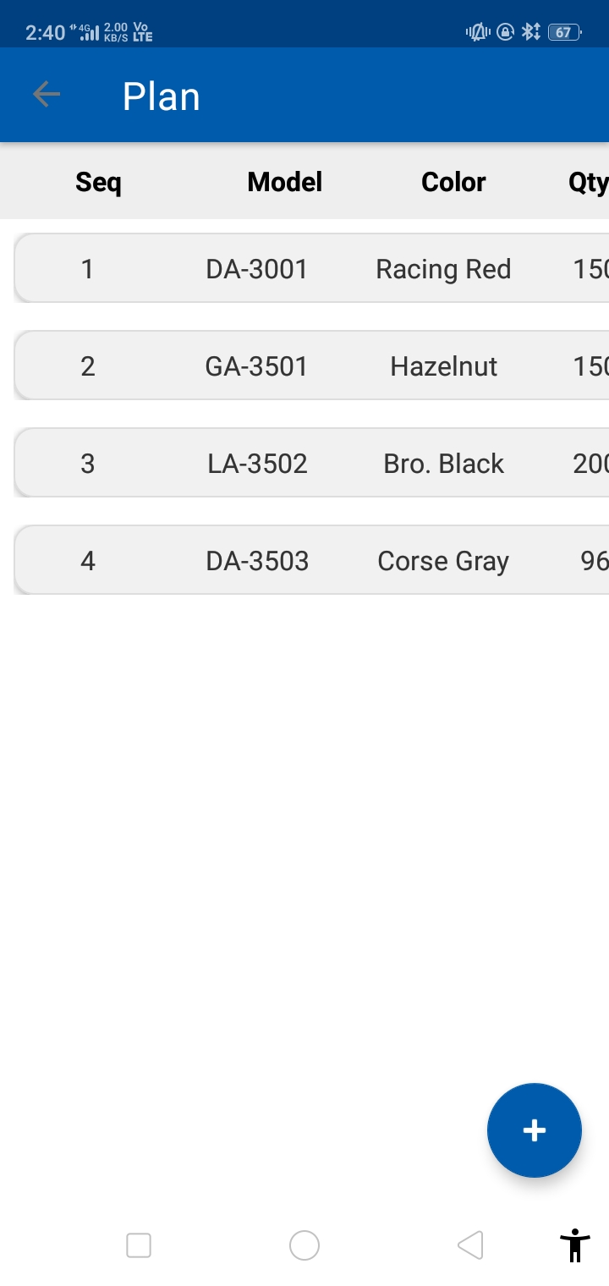
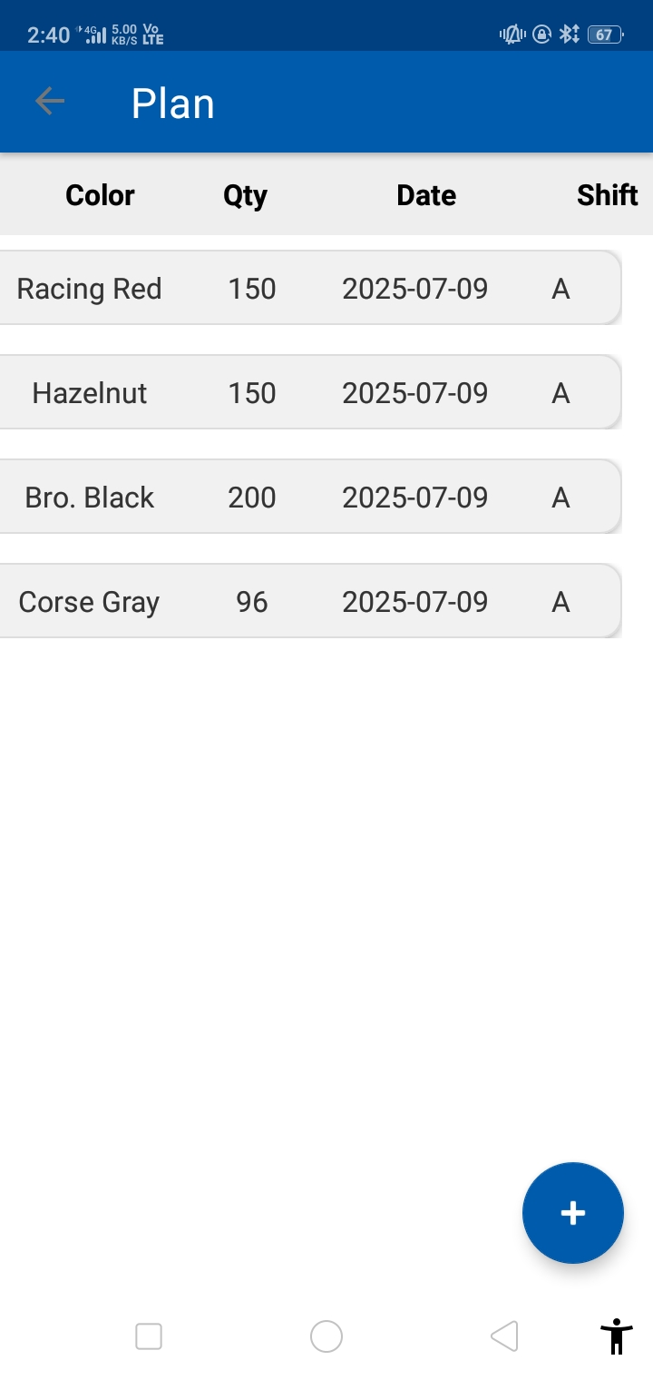
Production Planning in PartTracker
Adding a Production Plan
Select Date & Shift (auto-fetched but can be set manually)
Add Sequences with Model, Color (filtered by model), and Quantity
Plans are stored in the database and automatically appear when the shift begins
Dashboard updates in real time and shows progress using color-coded indicators
Step 1
Step 2
Easily schedule daily vehicle production with just a few taps.

Slide 26
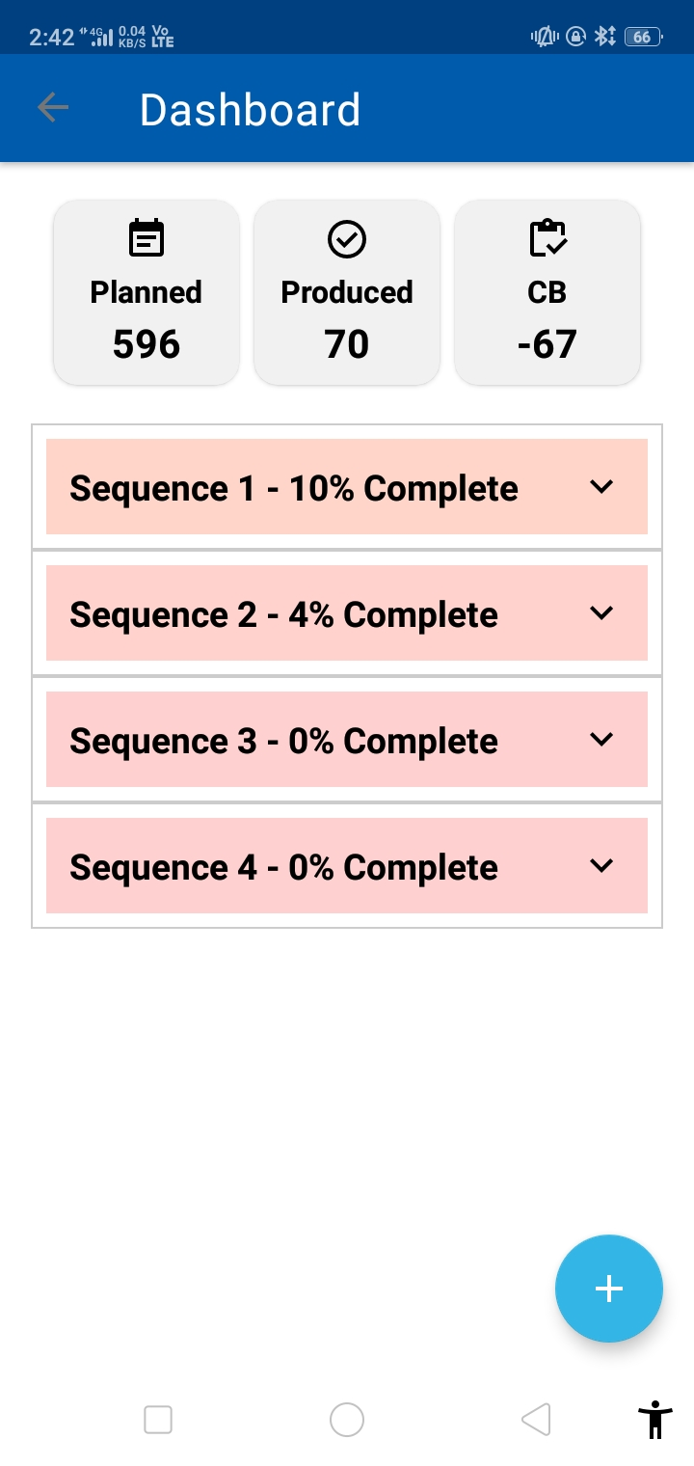
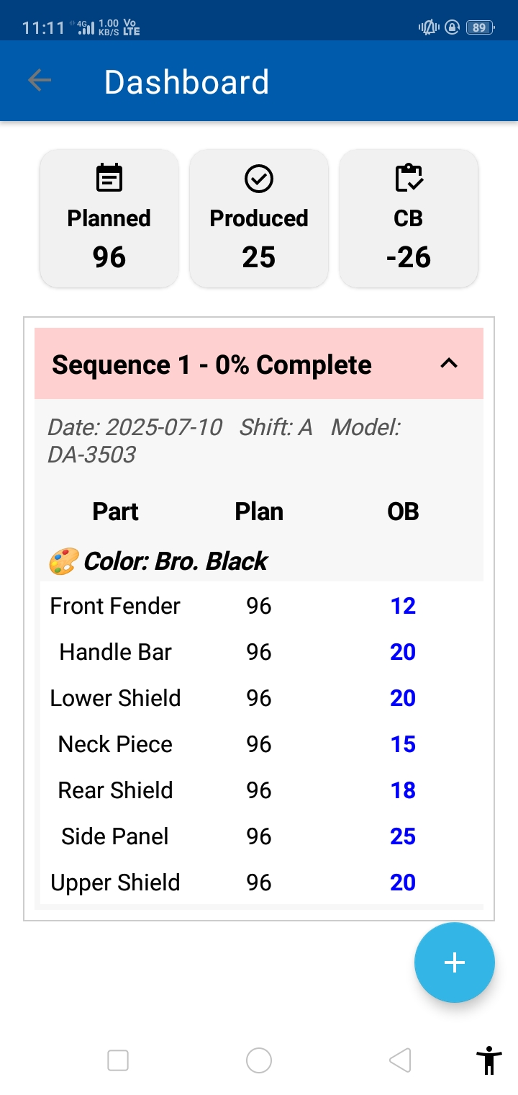
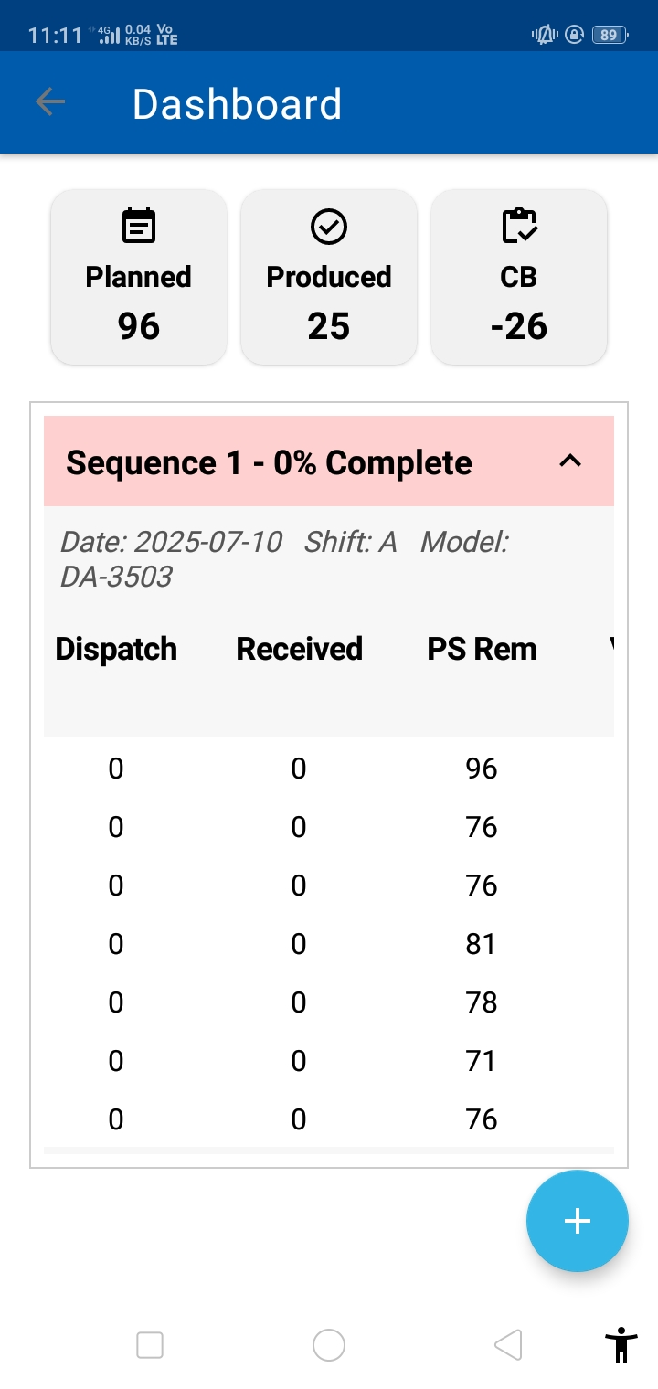
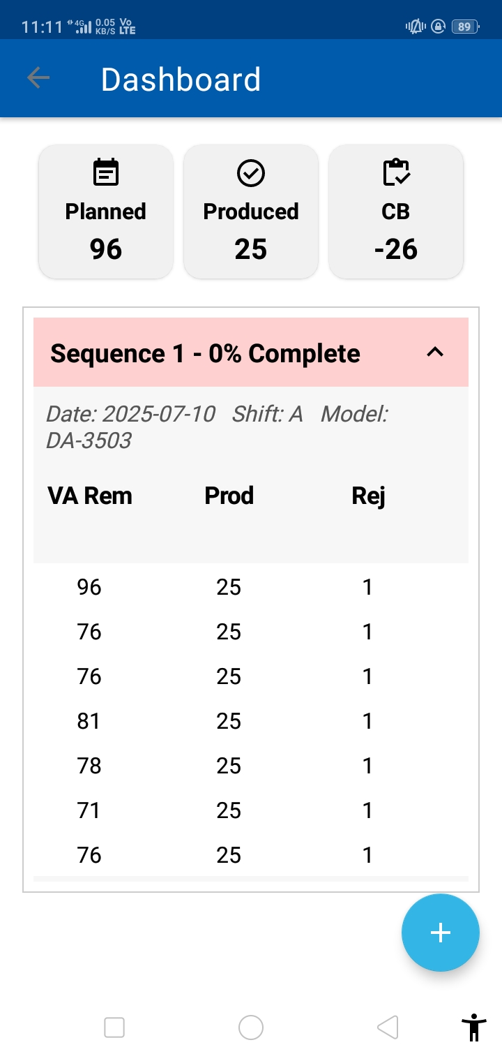
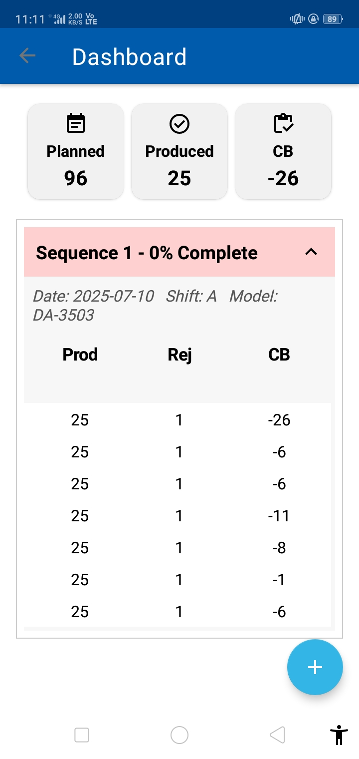
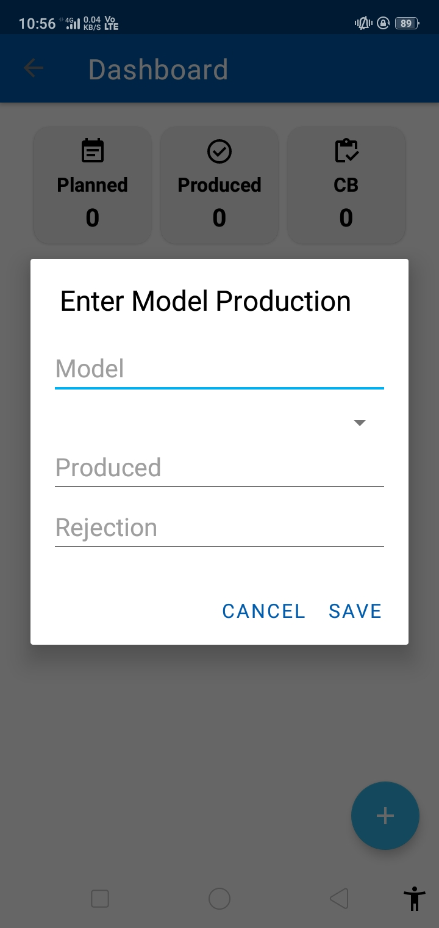
Tracking Real-Time Production with the Dashboard
The Dashboard lets you:
Track Planned vs. Produced vs. Closing Balance (CB)
View real-time progress of each sequence
Identify delays with color-coded alerts:
🔴 Low completion
🔴 Moderate completion
🔴 Fully completed
Take quick corrective action during the shift
Scrollable nested view
One glance, and the shop floor knows where to act.

Slide 27
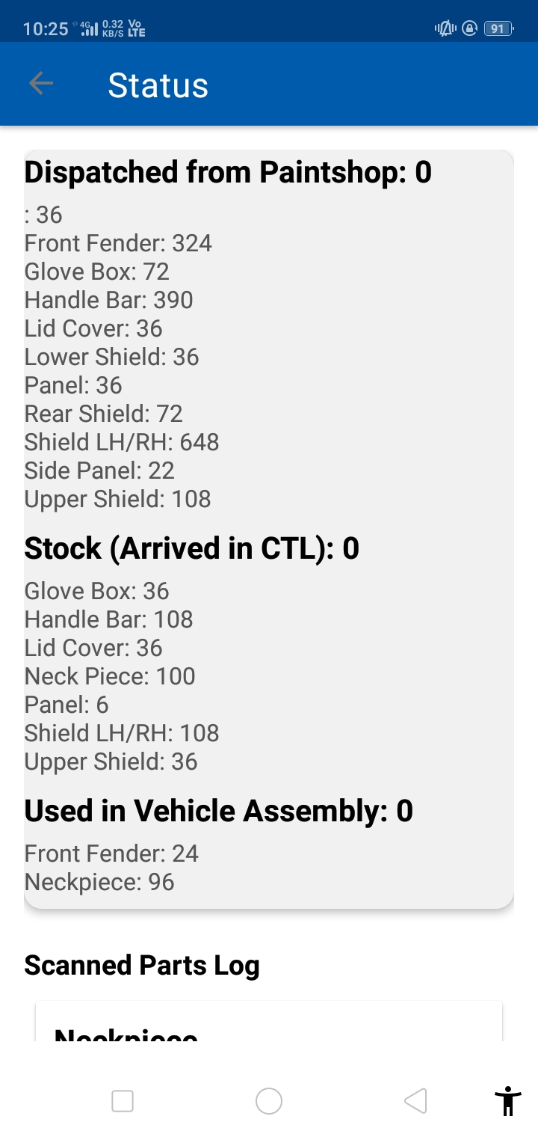
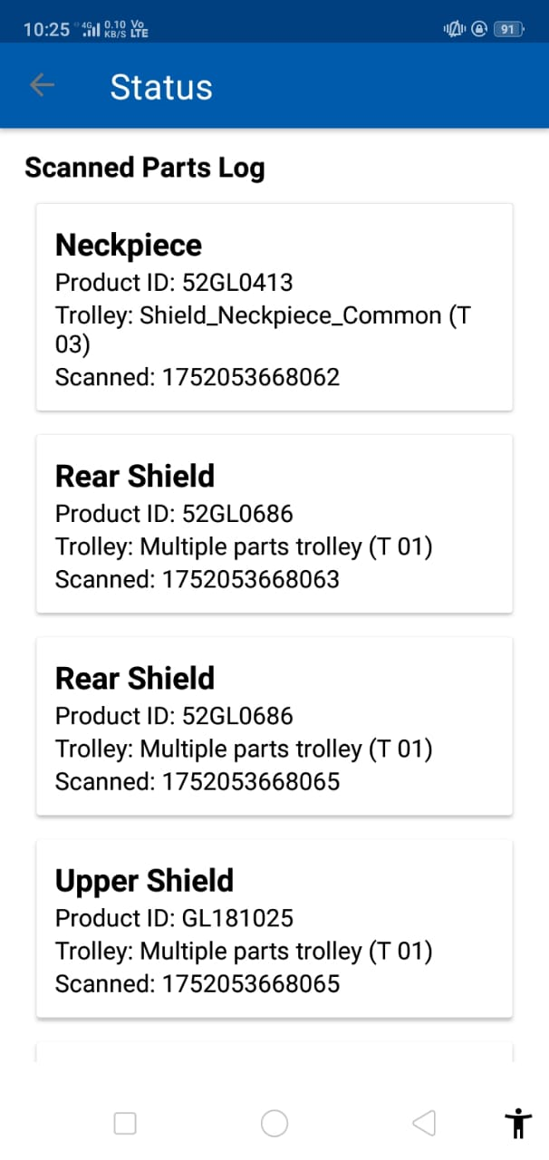
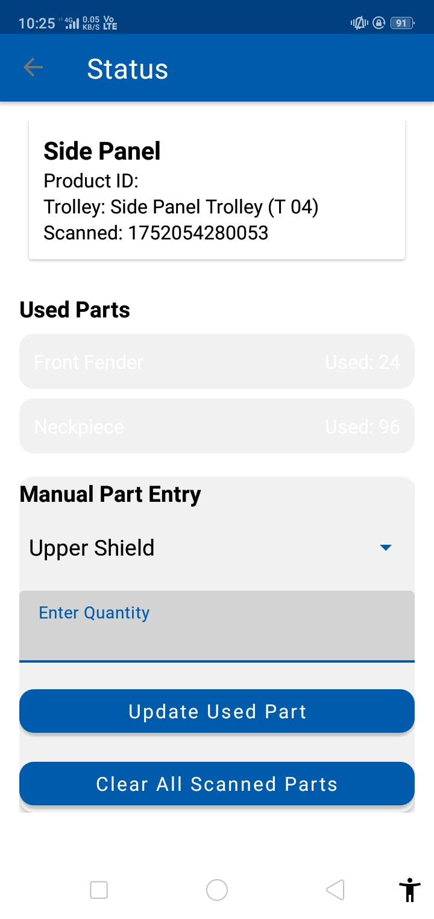
Cumulative Part Tracking with Status Panel
Status Tracking Overview
Shows cumulative count of all scanned parts
Tracks parts dispatched, received, and used
Updates continuously regardless of part color
Maintains detailed scan log with time, trolley ID, and part info
Operators manually update used parts in assembly
Enables complete visibility and traceability of parts across the shop floor.

Slide 28
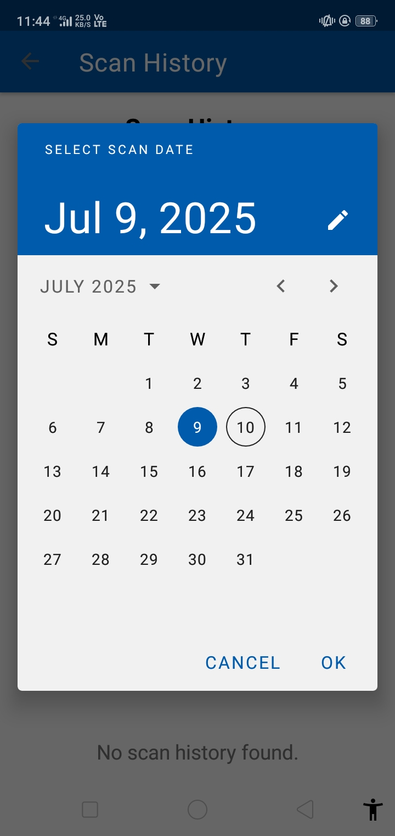
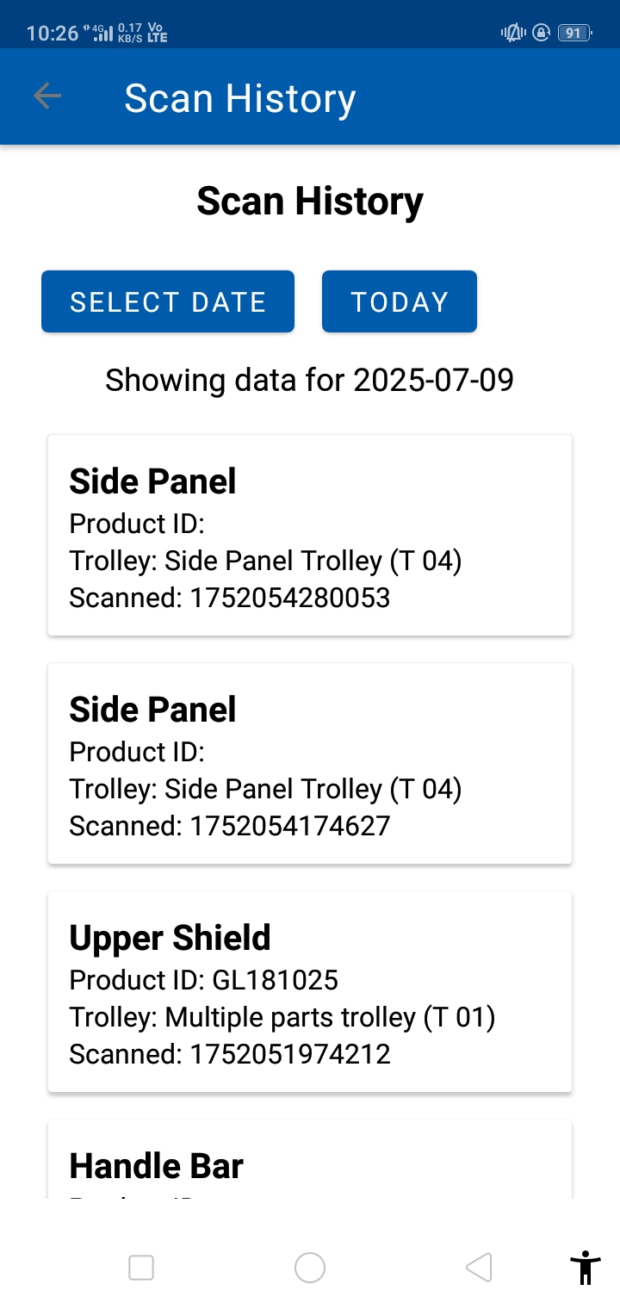
Full Traceability with Scan History
Scan History
Stores all scanned parts with date-wise logs
Enables quick reference to past scanned data
Ensures accountability and traceability of each part
Helps verify part movement across departments and shifts
Scan history enables audit-ready traceability across all operations.

Slide 29
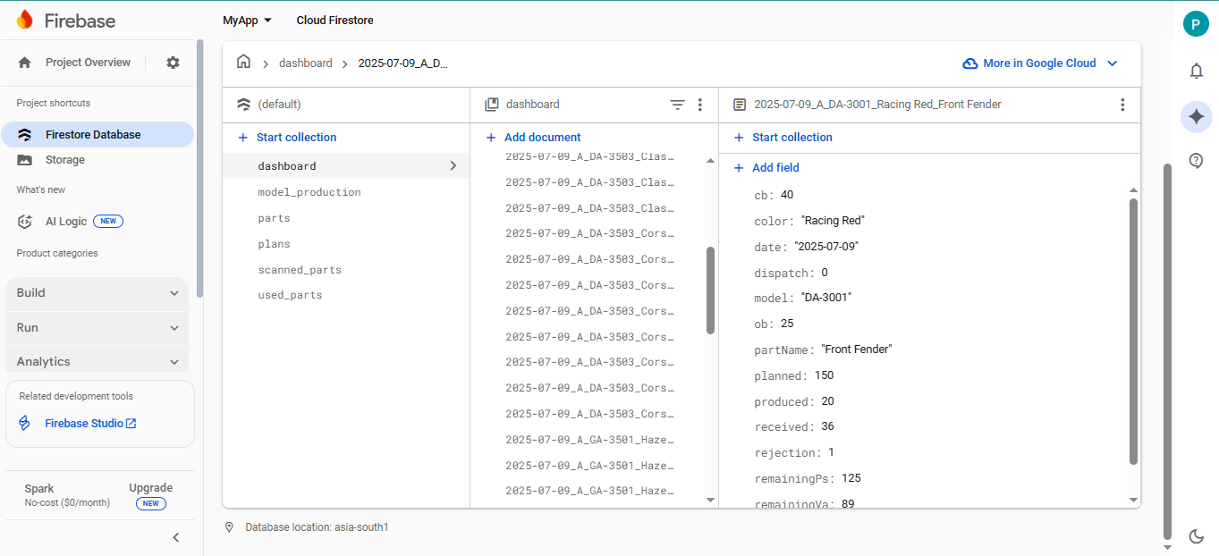
Cloud Infrastructure
Centralized cloud database for real-time data syncing
Stores planning, scanning, and production progress
Enables multi-device access with live updates
Auto-updates dashboard, status, and scan history
Collections: dashboard, plans, parts, scanned_parts, used_parts, model_production.

Slide 30
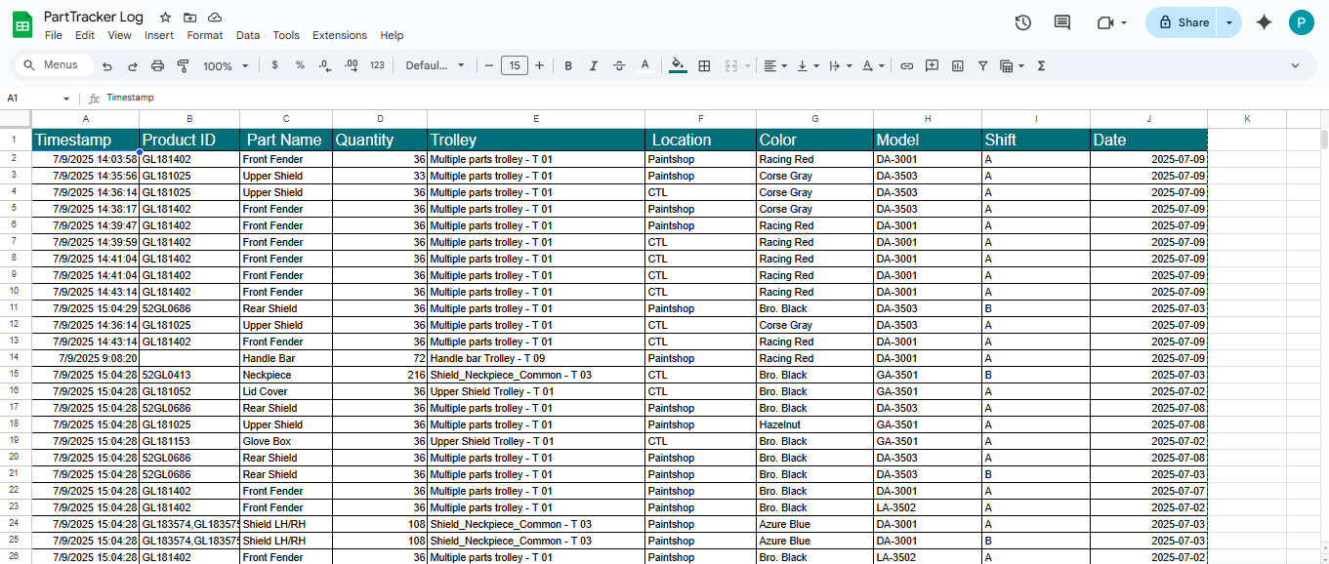
Data Storage in Google Sheets

Slide 31
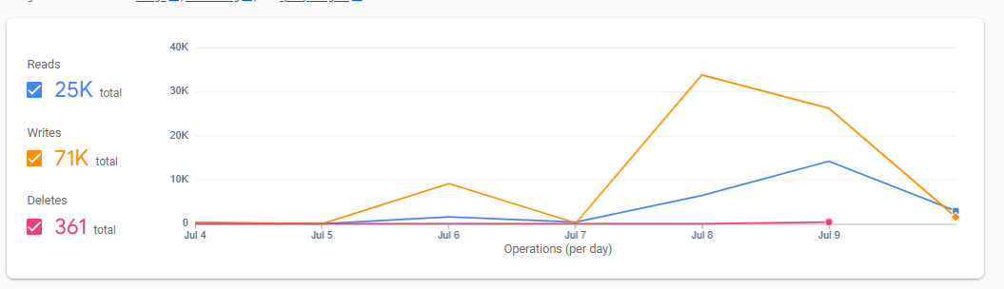
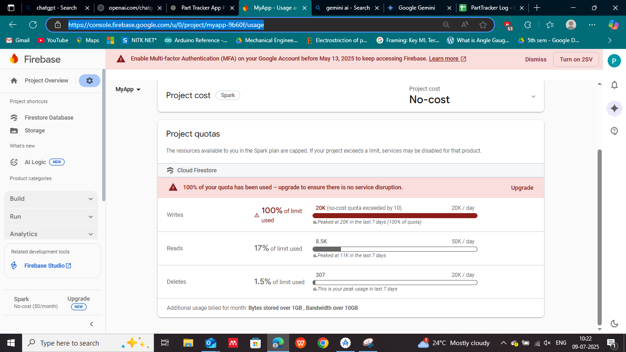
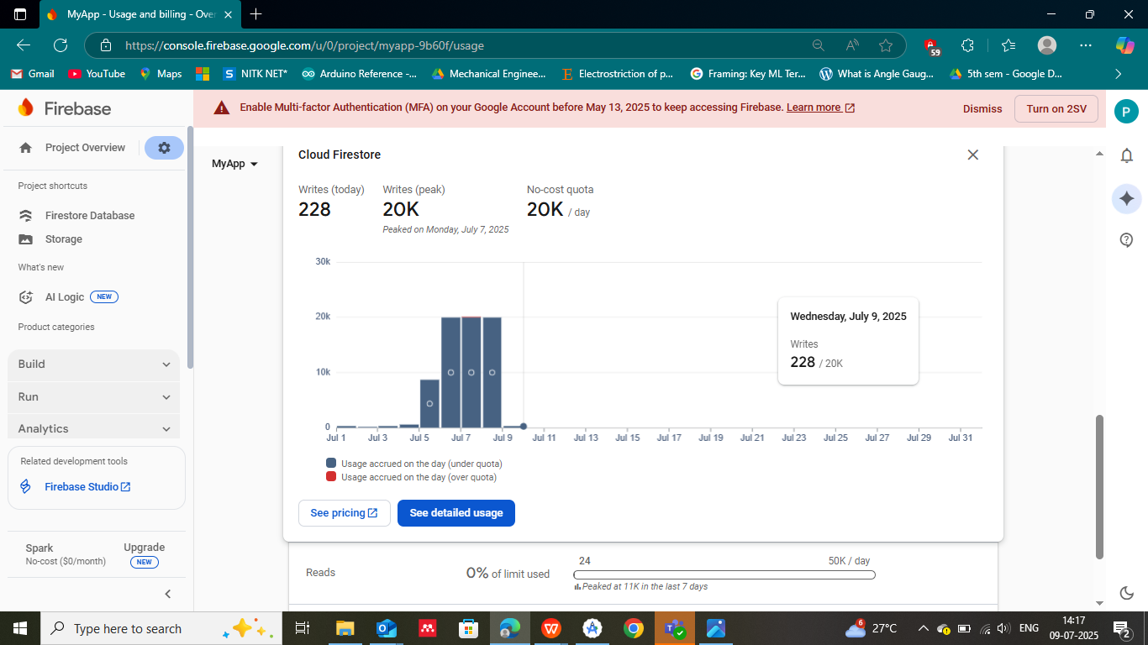
Issues To Overcome

Slide 32
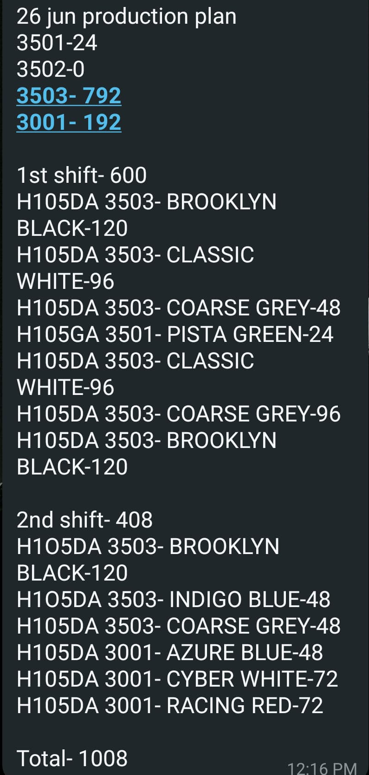
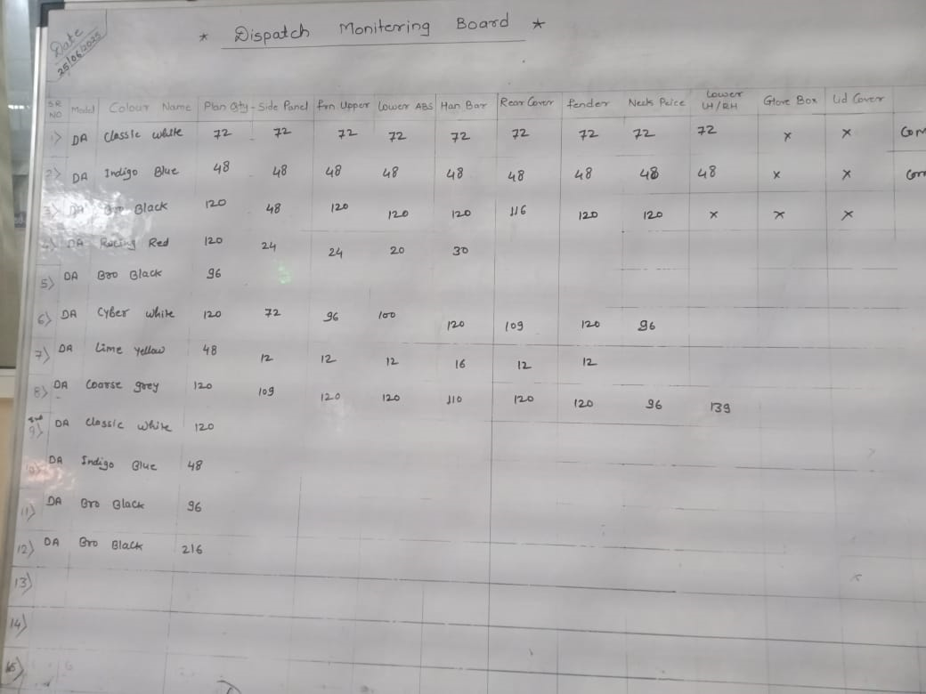
Results and Conclusion
What was the problem?
Part tracking was manual — whiteboards, WhatsApp
No proper communication between Paintshop & Vehicle Assembly
No live visibility during shift operations
What was the goal?​
To develop a single app that manages the entire part tracking workflow
Handle everything from daily shift planning to final dispatch
Eliminate manual errors and improve shop floor efficiency
Before: Plan being sent on whatsapp groups.
After: Plan being added on a centralised app available to all
Why was this app needed in the shop floor environment?
To streamline the tracking process and reduce manual effort
To replace scattered communication with a centralized tracking system
To support real-time decision-making across shifts and departments
Before: Production plans written manually on boards
After:Automated tracking based on Qr scanning .

Slide 33
Acknowledgment
I would like to express my heartfelt gratitude to Amar Sir for his constant guidance, support, and encouragement throughout the course of this project. His insights and direction helped me stay focused and move forward with clarity, especially during challenging moments.
I am also sincerely thankful to Arun Sir for his valuable assistance with the tasks assigned to me, which made the overall process more manageable and structured.
My special thanks to Vaibhav Sir for his hands-on support during the implementation phase of the application, ensuring smooth execution on the shop floor.
I would like to acknowledge the efforts of our HR team — Pranav Sir and Reeba Ma'am — for facilitating a smooth and well-coordinated process throughout.
Lastly, I extend my deep appreciation to the entire Paint Shop team for their cooperation, allowing me to conduct observations and helping me gain a deeper understanding of the workflow.
To everyone who supported me throughout this journey — thank you for being a part of it.

Slide 34
Thank You

